Slide 1

Indian education performance analysis
Name - Jasmeen
Course - B. Tech AI and ML

Slide 2

Company profile
Certification: ISO 9001:2015 Certified
. Specializations:
- Web Development
- Mobile Application Development
- Custom Software Development
- UI/UX Design
- Hosting Services
- Digital Marketing
Services:
- Advanced IT solutions supporting the entire business
- Consulting to system development
- Deployment
- Quality Assurance
- 24x7 Support
Headquarters: Jalandhar
Branch Office: Hoshiarpur
Branch Office: Hoshiarpur

Slide 3
Table of Content
1. Introduction
3. Project Objectives
5. Project Requirements
6. Data Collection and Preprocessing
7. Results and Visualizations
9. Future Scope
10. Thank You
8. Conclusion
4. Features
2. Problem statement

Slide 4
Introduction
-The Indian School Performance Analysis project aims to analyze educational data from schools across India.
- It focuses on key factors such as
student enrollment
dropout rates
school infrastructure.

Slide 5
Problem Statement
Educational performance varies across Indian states and UTs.
High dropout rates and unequal infrastructure remain major challenges.
Comparing educational indicators manually is difficult.
An interactive dashboard is needed to analyze trends and identify areas for improvement.

Slide 6
Objectives
To analyze school education data across different states of India.
To study student enrollment, dropout rates, and school infrastructure.
To identify trends and patterns in educational performance.
To visualize the data using graphs and charts for better understanding.
To generate meaningful insights that can support educational planning and decision-making.

Slide 7

Features
Interactive dashboard for educational data analysis.
State-wise comparison of educational performance.
Analysis of dropout rates, enrollment, and infrastructure.
Clear visual representation using charts and graphs.
Simple and user-friendly interface.

Slide 8
Requirements
Python - Core programming language
Python libraries -:
Pandas - Data cleaning and analysis
NumPy - Numerical computations
Seaborn – for data visualization
Streamlit - Interactive dashboard
VS Code - Code editor and development environment
Plotly – It allows to zoom, hover over points, interact with visualizations, making data analysis more effective.

Slide 9
Data collection and preprocessing
Data collection – Indian school education statics from kaggle
Data preprocessing – removed duplicate and missing values
Columns renamed for better readibility
Checked and corrected datatypes
EDA (Exploratory data analysis)-Compared state-wise educational performance
Identified trends and patterns.
Data Visualization-Created bar charts, Line charts, Pie charts.

Slide 10
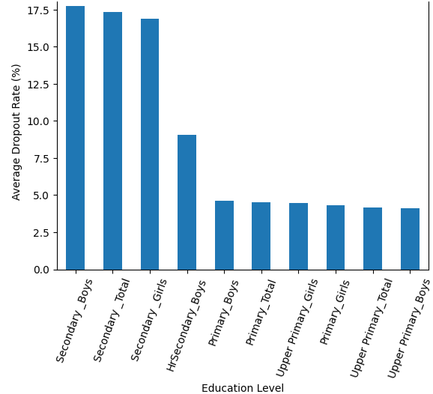
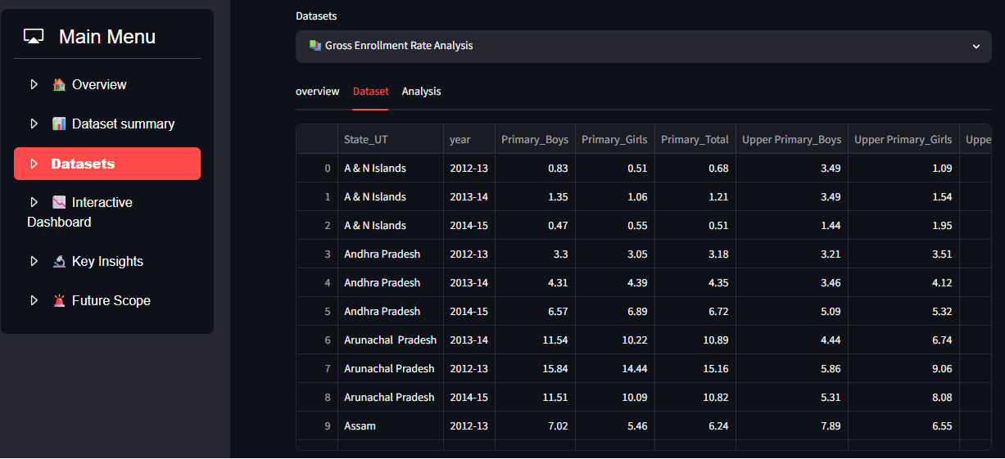
Results and Visualizations
Dropout rates by Education level
Dashboard

Slide 11
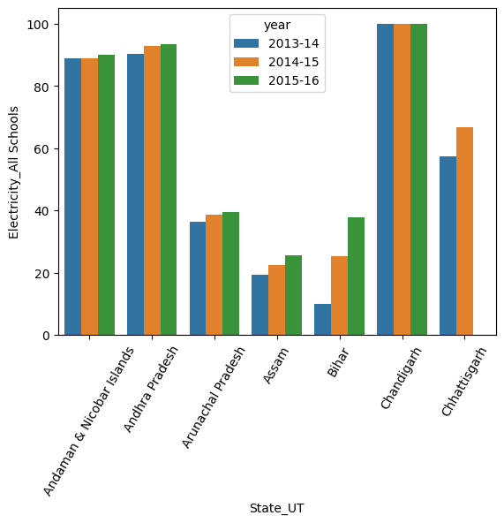
Conclusion
Compared state-wise educational performance.
Identified key trends in enrollment, dropout rates, and school infrastructure.
Visualized the data using charts and graphs for better understanding.
Generated meaningful insights to support educational planning and decision-making.
Demonstrated the effective use of Python for data analysis and visualization.

Slide 12
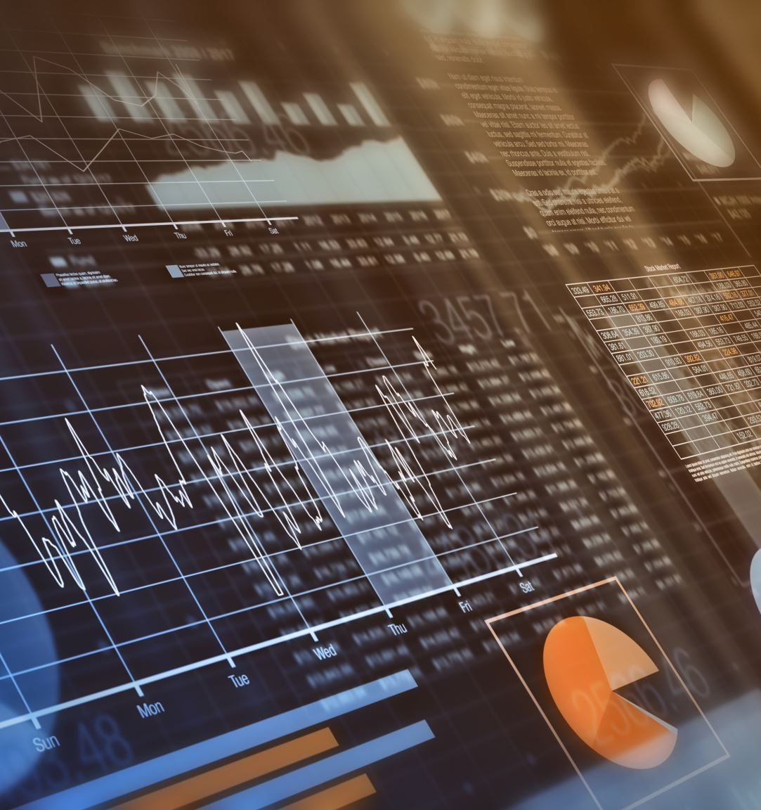
Future Scope
Perform district-level or school-level analysis for more detailed educational insights.
Use machine learning to predict future enrollment and dropout rates.
Expand the analysis by including additional educational factors.
Enhance the dashboard with advanced features.

Slide 13
Thank you !

